Slide 1

Optimizing Queries on SQL-Level
Thomas Glas
Guided Research
Supervised by Alexander Beischl
Technische Universität München
TUM School of Computation, Information and Technology
Lehrstuhl für Datenbankensysteme
München, 04. April 2023

Slide 2
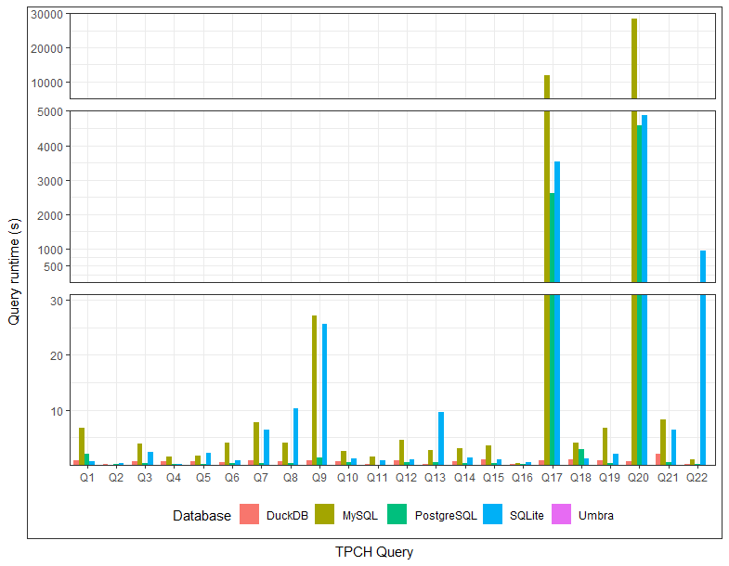
What‘s the problem?
~8h
~3h
76 min
45 min
(SF 1)
Notes:
Ran TPCH benchmark on 4 open source database systems (+ Umbra for comparison): Q17 and Q20 noticeably long runtimes
Taking a look at DuckDB and Umbra, we see that these queries can be executed quickly, and don’t need to be so expensive, so what’s the difference between these systems?

Slide 3
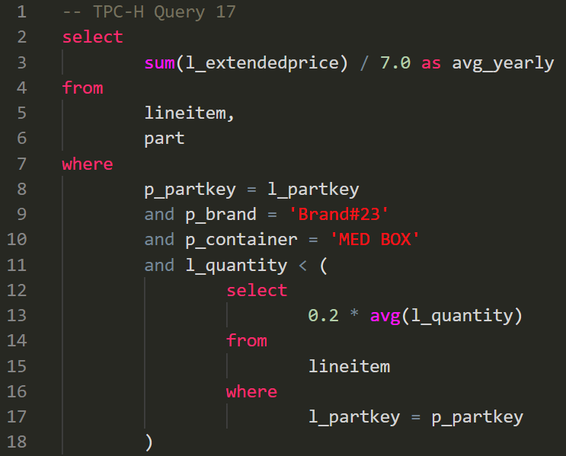
Correlated Subqueries…
Notes:
Taking a look at Q17, we see it contains a correlated subquery
This causes the long runtimes, since subquery needs to be executed for every tuple produced by outer query
But there is an algorithm (by Prof. Neumann and Kemper) which can decorrelate arbitrary queries
Unfortunately, only DuckDB has implemented it, and PostgreSQL/MySQL/SQLite all cannot decorrelate these queries…
Implementing the algorithm for each database, and merging into their codebase would be a lot of work
And there would still be many other databases which haven’t implemented the algorithm
So we thought of a solution how we can solve this problem for all databases at once

Slide 4
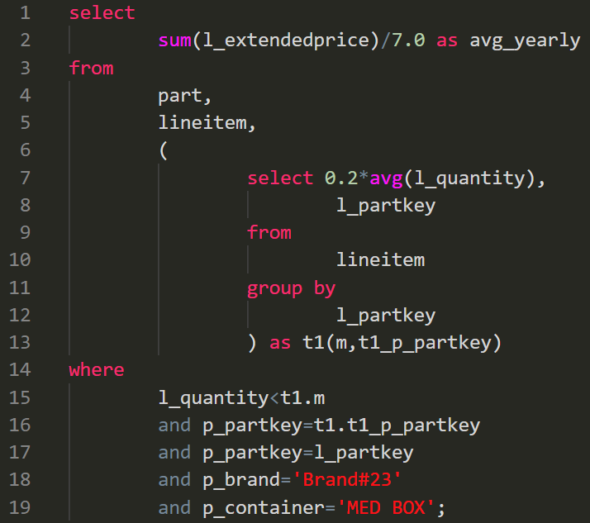
We can decorrelate this query in SQL
Notes:
What is common between relational databases: they take SQL as input
Unnesting correlated queries can also be done on SQL-level
If we build a query decorrelation tool on SQL level, we could bring the query unnesting algorithm to all relational databases

Slide 5
Architecture
SQL
SQL Parser
AST
SQL-to-RA Parser
RA Tree
RA Optimizer
RA Tree
RA-to-SQL Deparser
SQL
Notes:
Achitecture of our tool:
Parse SQL, translate SQL to relational algebra, perform optimizations on relational algebra, deparse back to SQL
From here, SQL can be passed to arbitrary relational databases

Slide 6
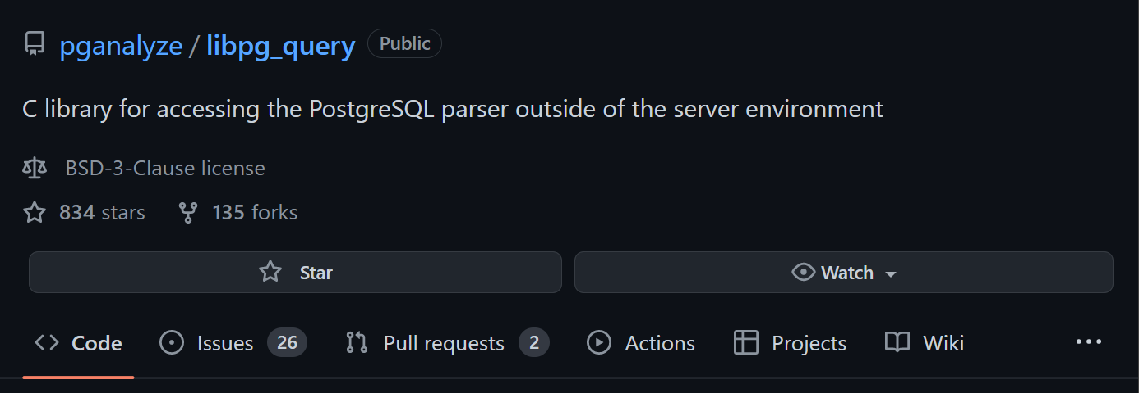
SQL Parser
SQL
SQL Parser
AST
SQL-to-RA Parser
RA Tree
RA Optimizer
RA Tree
RA-to-SQL Deparser
SQL
Notes:
- Decided to use Postgres’ SQL parser, as Postgres’ SQL dialect is the most widely used, give us widest coverage across databases systems
Used libpq_query library, which extracts the PostgreSQL parser for use outside of the server environment
Output is an AST

Slide 7
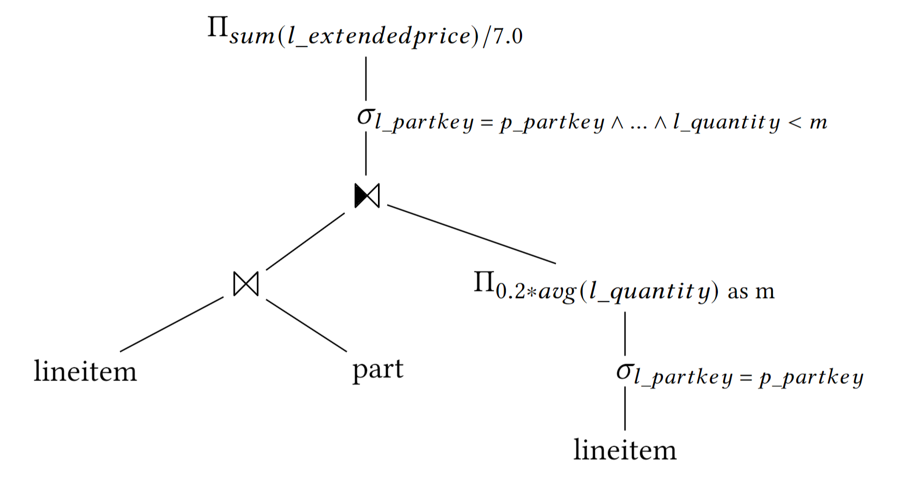
SQL-to-RA Parser
SQL
SQL Parser
AST
SQL-to-RA Parser
RA Tree
RA Optimizer
RA Tree
RA-to-SQL Deparser
SQL
Notes:
Implemented our own SQL to relational algebra parser
The scope of our parser is limited to the SQL constructs occurring in the TPCH queries
Here example of TPCH Q17
We check whether subqueries are correlated and if yes, they are joined with a dependent join operator
We mark the predicate containing the subquery with a marker, and have the same marker in the subquery subtree. Allows us to link the subtree to the predicate

Slide 8
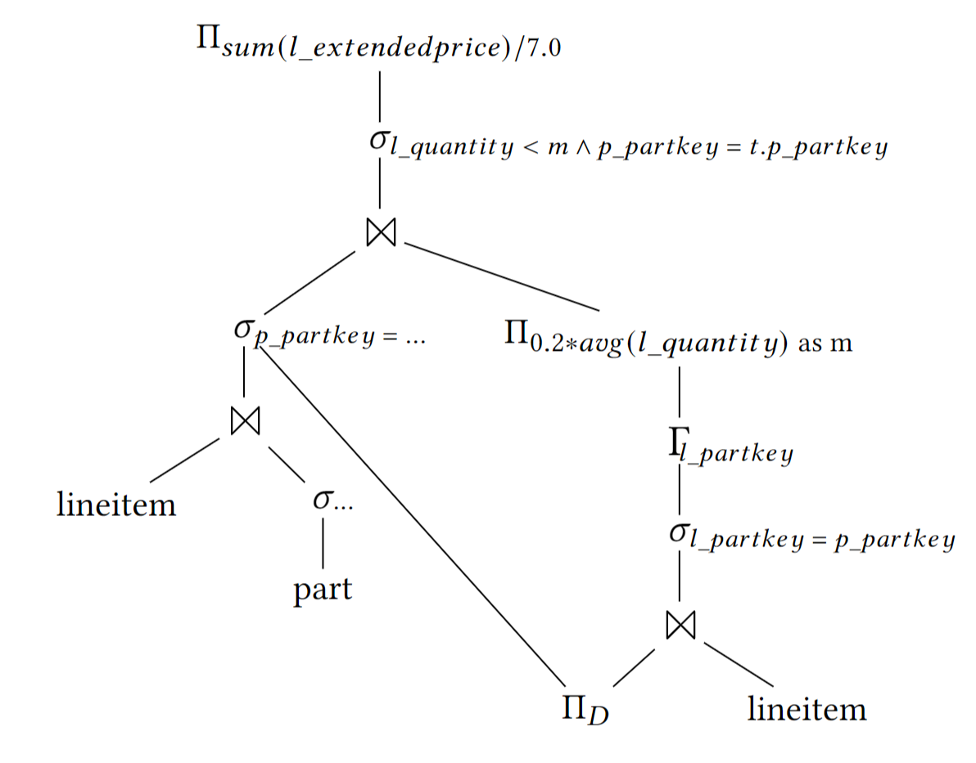
RA Optimizer
SQL
SQL Parser
AST
SQL-to-RA Parser
RA Tree
RA Optimizer
RA Tree
RA-to-SQL Deparser
SQL
Notes:
Optimization starts with a predicate pushdown
Then we follow the general query unnesting algorithm, as described in Prof. Neumann and Kemper’s paper
End up with query tree, which does not contain any dependent joins anymore
Algorithm introduces sideways information passing
Optionally, this can be decoupled under certain conditions
Coming back to predicate pushdown: if we think about it, predicate pushdowns by themselves will not change the query on SQL-level
Even if this predicate is pushed down to here, when deparsed back to SQL, the predicate will still be part of the where clause, as before
The only reason we need it, is so that the sideways information passing can take advantage of the predicate, this will be represented when deparsing back to SQL

Slide 9
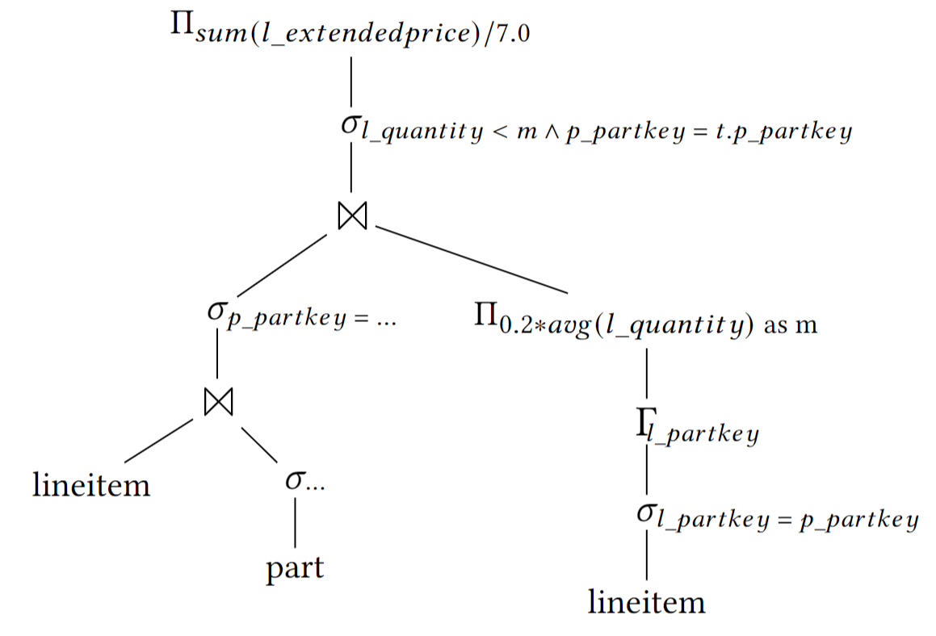
RA-to-SQL Deparser
SQL
SQL Parser
AST
SQL-to-RA Parser
RA Tree
RA Optimizer
RA Tree
RA-to-SQL Deparser
SQL
Notes:
Left is the optimized tree after decoupling sideways information passing
After optimizing, the relational algebra tree is deparsed back to SQL
Implemented our own simple deparser, also following Postgres’ SQL dialect
Here an example of optimized RA tree for Q17, after decoupling the sideways information passing

Slide 10
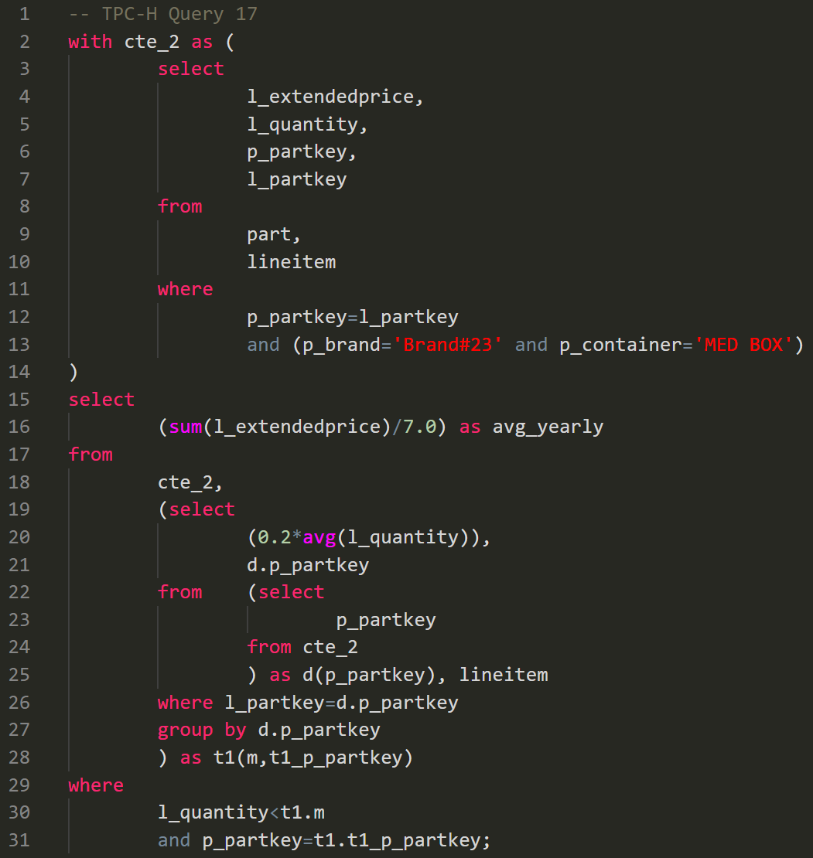
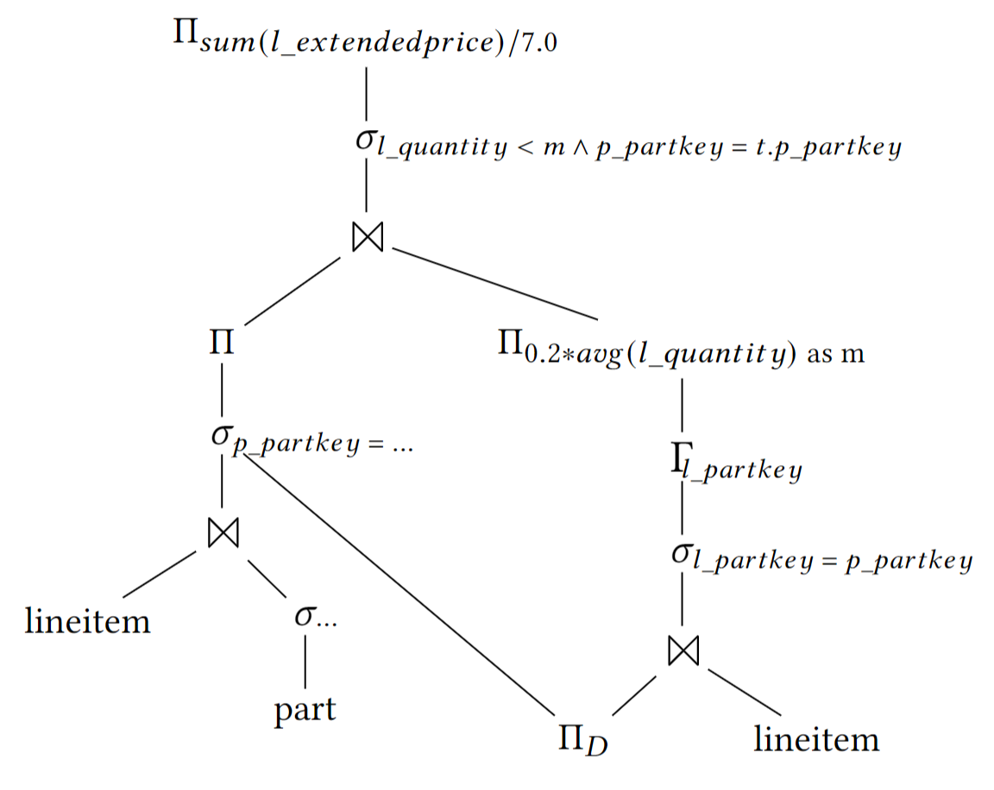
To decouple, or not to decouple
Notes:
The last optional step of the general unnesting algorithm is to decouple the sideways information passing
Tool can decorrelate SQL queries with and without decoupling
Here is Q17 as an example, without decoupling
We represent sideways information passing using CTE
Shared part of tree extracted into CTE, main tree selects from tree

Slide 11
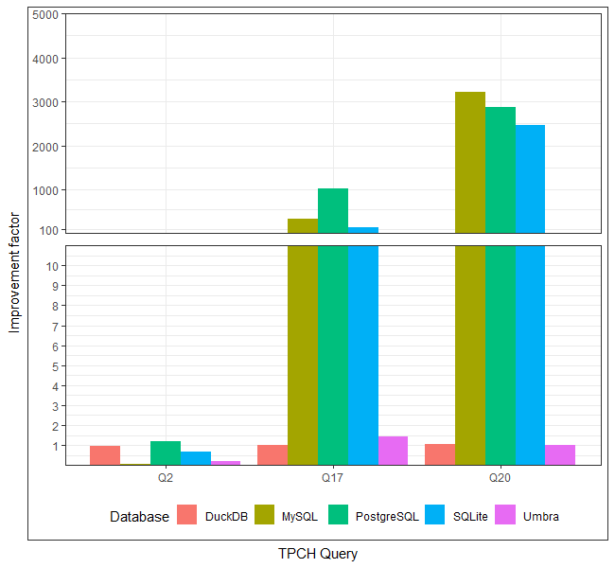
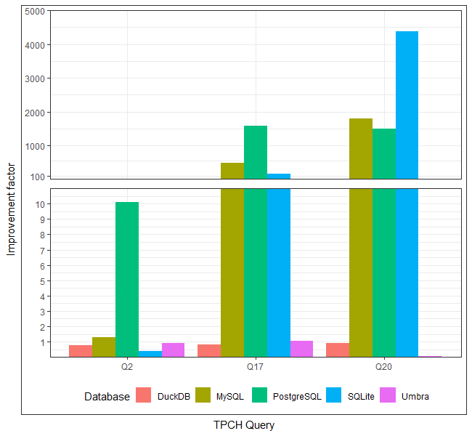
To decouple, or not to decouple
Decoupled
Not decoupled
(SF 1)
(SF 1)
Notes:
Comparing query runtimes for decoupled and not decoupled queries…
For these four cases, the query without decoupling performed significantly better
Shows that even though decoupling makes queries simpler, for our tool, it is important to have the option of generating decoupled and not decoupled queries

Slide 12
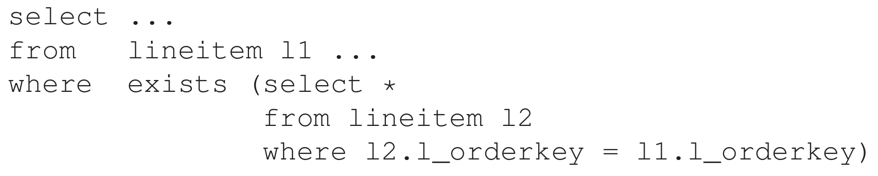
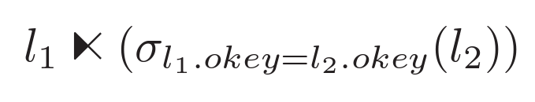
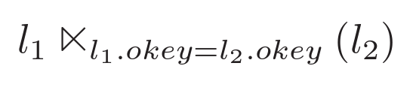
Correlated exists and in subqueries
Notes:
Correlated subqueries in “exists” and “in” are cases which need separate handling:
Taking a look at example:
Decorrelating subqueries in “exists” subqueries is straight forward in relational algebra
“exists” clause is translated into dependent semi-join
correlating predicate in selection is extracted and merged with semi join operator
But, if we translate this back to SQL, we would end up with the same query again

Slide 13
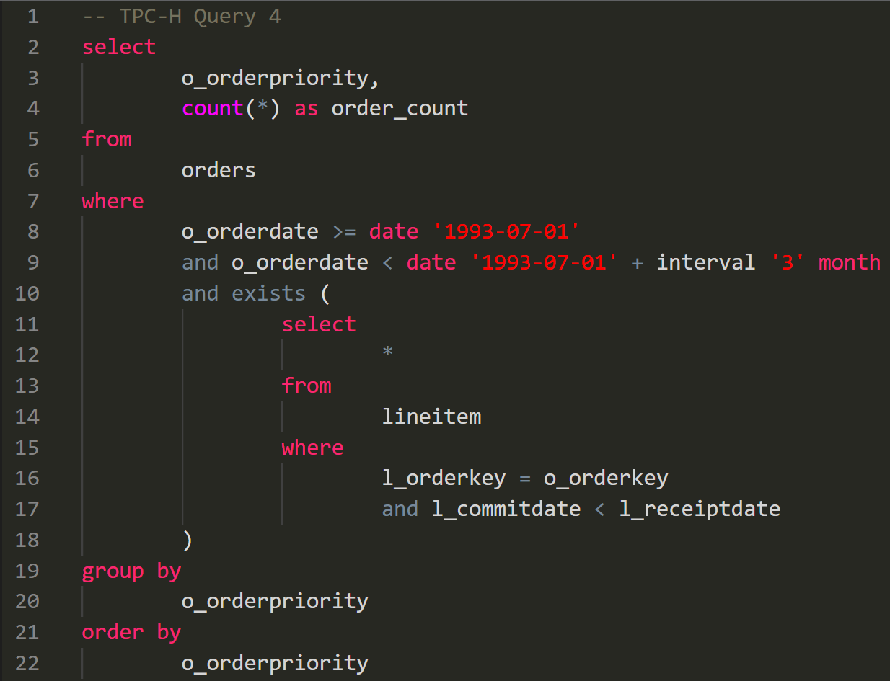
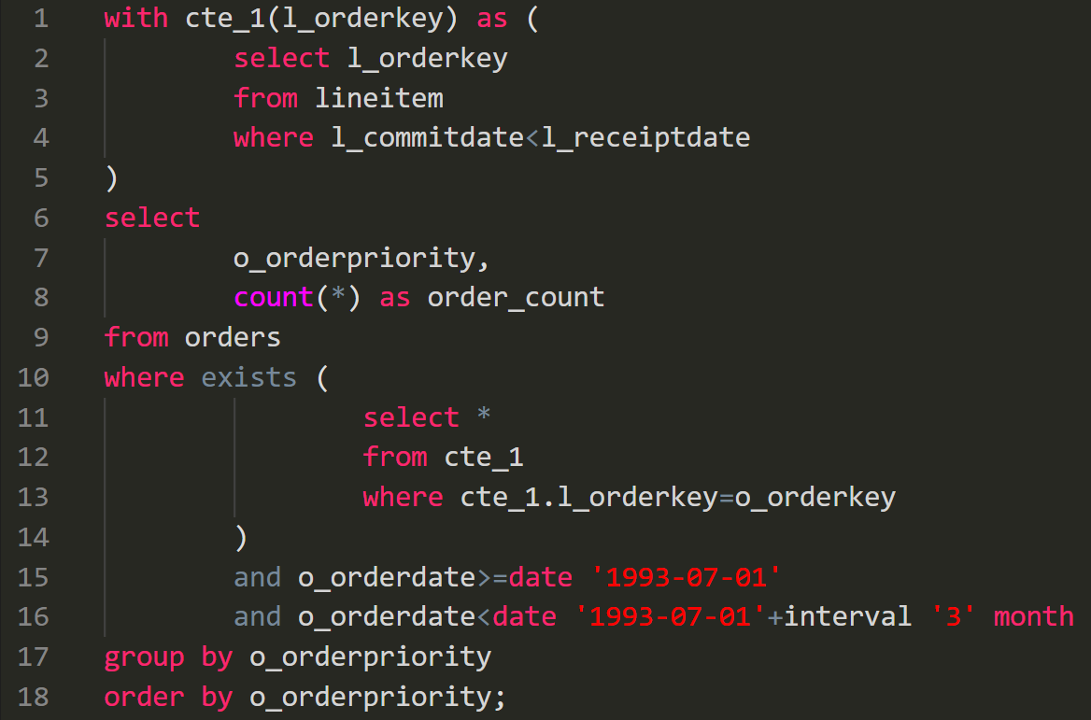
Correlated exists and in subqueries
Notes:
Instead, for correlated subqueries in “exists” and “in” predicates:
we extract subquery to CTE (removing correlating predicates)
In original subquery, we select from CTE
Predicate does not need to be executed for every subquery execution

Slide 14
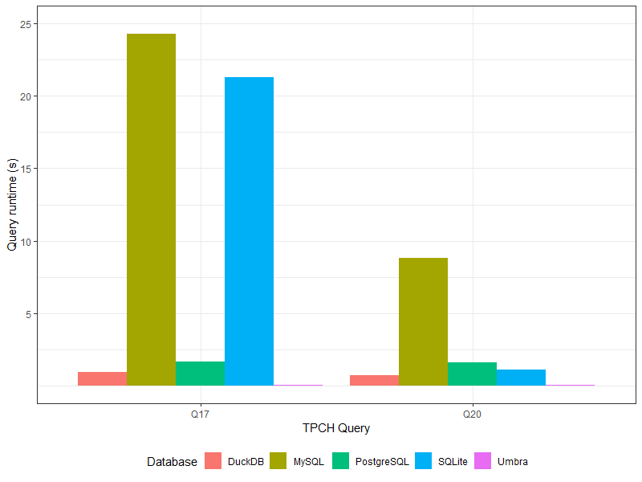
Results
(SF 1)
Notes:
Figure shows the runtimes of the long running queries Q17 and Q20 after applying our tool
For databases which have not implemented arbitrary query unnesting, we can reduce runtimes for certain queries from hours to seconds, bringing such queries from the “practically unusable” territory into perfectly usable
This is in form of a modular optimization tool which can sit on top of any relational database systems
Limits: semi (mark) joins, lack metadata typically available to optimizers;

